Slide 1


Slide 2
How fast is I/O hardware?
The data rate mentioned below don’t reflect the technological advancement at the present time. They are presented just for the sake of demonstrating how I/O activities are slow.
Device | Data rate
Keyboard | 10 bytes/sec
Mouse | 100 bytes/sec
Printer / scanner | 200 KB/sec
USB | 1.5 MB/sec
Digital camcorder | 4 MB/sec
Fast Ethernet | 100 MB/sec
Hard drive | 20 MB/sec
FireWire (IEEE 1394) | 50 MB/sec
XGA monitor | 60 MB/sec
PCI bus | 500 MB/sec

Slide 3
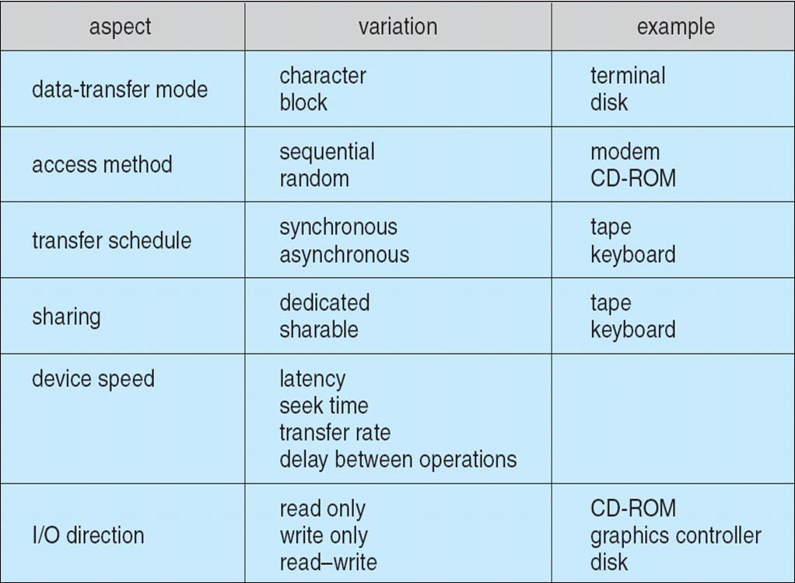
Characteristics of I/O Devices

Slide 4
Device controllers
I/O devices have components
  Mechanical component
  Electronic component
Electronic component controls the device
  May be able to handle multiple devices
  May be more than one controller per mechanical component (example: hard drive)
Controller's tasks
  Convert serial bit stream to block of bytes
  Perform error correction as necessary
  Make available to main memory

Slide 5

Memory
0xFFF…
I/O ports
0
Separate
I/O & memory
space
Memory-mapped I/O
Hybrid: both
memory-mapped &
separate spaces

Slide 6
How is memory-mapped I/O done?
Single-bus
  All memory accesses go over a shared bus
  I/O and RAM accesses compete for bandwidth
Dual-bus
  RAM access over high-speed bus
  I/O access over lower-speed bus
  Less competition
  More hardware (more expensive…)
CPU
Memory
I/O
CPU
Memory
I/O
This port allows I/O devices
access into memory

Slide 7



Slide 8
I/O software: goals
Device independence
  Programs can access any I/O device
  No need to specify device in advance
Uniform naming
  Name of a file or device is a string or an integer
  Doesn’t depend on the machine (underlying hardware)
Error handling
  Done as close to the hardware as possible
  Isolate higher-level software
Synchronous vs. asynchronous transfers
  Blocked transfers vs. interrupt-driven
Buffering
  Data coming off a device cannot be stored in final destination
Sharable vs. dedicated devices

Slide 9
Programmed I/O
There are three fundamentally different ways that I/O can be performed
  Programmed I/O,
  interrupt-driven I/O and
  I/O using DMA

Slide 10

User
Printed
page
Printed
page
Printed
page
ABCD
EFGH
ABCD
EFGH
ABCD
EFGH
A
AB
Kernel
ABCD
EFGH
ABCD
EFGH

Slide 11

copy_from_user (buffer, p, count); // copy into kernel buffer
for (j = 0; j < count; j++) { // loop for each char
while (*printer_status_reg != READY)
; // wait for printer to be ready
*printer_data_reg = p[j]; // output a single character
}
return_to_user();

Slide 12

Consider the case of printing on a printer that does not buffer characters but prints each one as it arrives:
  The CPU will be left idle for a significant amount of time for waiting to receive the next character
  Solution: use of interrupt so that CPU can work on other things until the characters are buffered for printing.

Slide 13

The problem with interrupt driven I/O is that an interrupt occurs on every character.
The solution is to use DMA:
  Let the DMA controller feed the characters to the printer one at time, without the CPU being bothered.

Slide 14

Programmed I/O
Interrupt Driven I/O
I/O using DMA
Note: Present a comparative analysis of the three I/O techniques

Slide 15

User-level I/O software & libraries
User
Device-independent OS software
Operating
system
(kernel)
Device drivers
Interrupt handlers
Hardware

Slide 16
Interrupt handlers
Interrupt handlers are best hidden
  Driver starts an I/O operation and blocks
  Interrupt notifies of completion
Interrupt procedure does its task
  Then unblocks driver that started it
  Perform minimal actions at interrupt time
    Some of the functionality can be done by the driver after it is unblocked
Interrupt handler must
  Save regs not already saved by interrupt hardware
  Set up context for interrupt service procedure

Slide 17

Device drivers
Device drivers go between device controllers and rest of OS
  Drivers standardize interface to widely varied devices
Device drivers communicate with controllers over bus
  Controllers communicate with devices themselves
User
space
User
program
Kernel
space
Rest of the OS
Keyboard
driver
Disk
driver
Keyboard
controller
Disk
controller

Slide 18
Device-independent I/O software
Device-independent I/O software provides common “library” routines for I/O software
Helps drivers maintain a standard appearance to the rest of the OS
Uniform interface for many device drivers for
  Buffering
  Error reporting
  Allocating and releasing dedicated devices
  Suspending and resuming processes
Common resource pool
  Device-independent block size (keep track of blocks)
  Other device driver resources

Slide 19

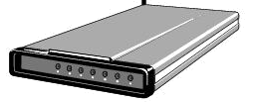
User
space
User
space
User
space
User
space
Kernel
space
Kernel
space
Kernel
space
Kernel
space
2
2
1
1
3
Unbuffered
input
Buffering in
user space
Buffer in kernel
Copy to user space
Double buffer
in kernel

Slide 20

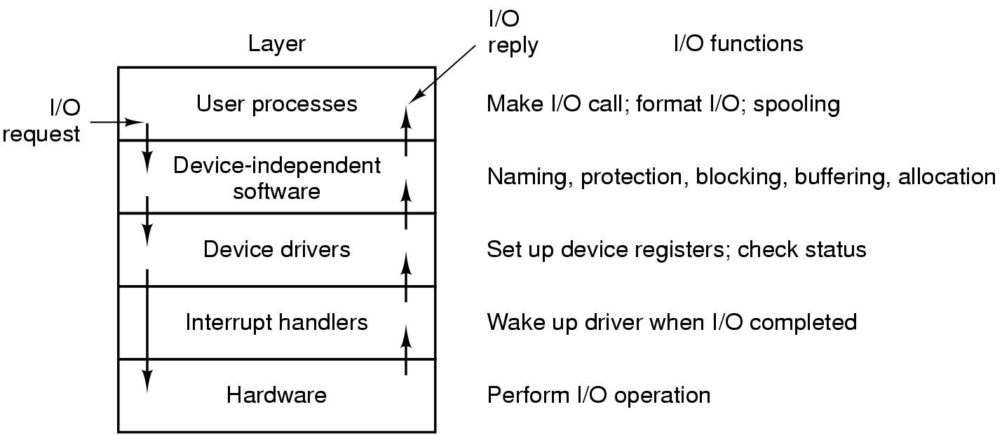

Slide 21
Disk drive structure
Data stored on surfaces
  Up to two surfaces per platter
  One or more platters per disk
Data in concentric tracks
  Tracks broken into sectors
    256B-1KB per sector
  Cylinder: corresponding tracks on all surfaces
Data read and written by heads
  Actuator moves heads
  Heads move in unison
head
sector
platter
track
cylinder
surfaces
spindle
actuator

Slide 22
Disk drive specifics
 | IBM 360KB floppy | WD 18GB HD
Cylinders | 40 | 10601
Tracks per cylinder | 2 | 12
Sectors per track | 9 | 281 (average)
Sectors per disk | 720 | 35742000
Bytes per sector | 512 | 512
Capacity | 360 KB | 18.3 GB
Seek time (minimum) | 6 ms | 0.8 ms
Seek time (average) | 77 ms | 6.9 ms
Rotation time | 200 ms | 8.33 ms
Spinup time | 250 ms | 20 sec
Sector transfer time | 22 ms | 17 μsec

Slide 23
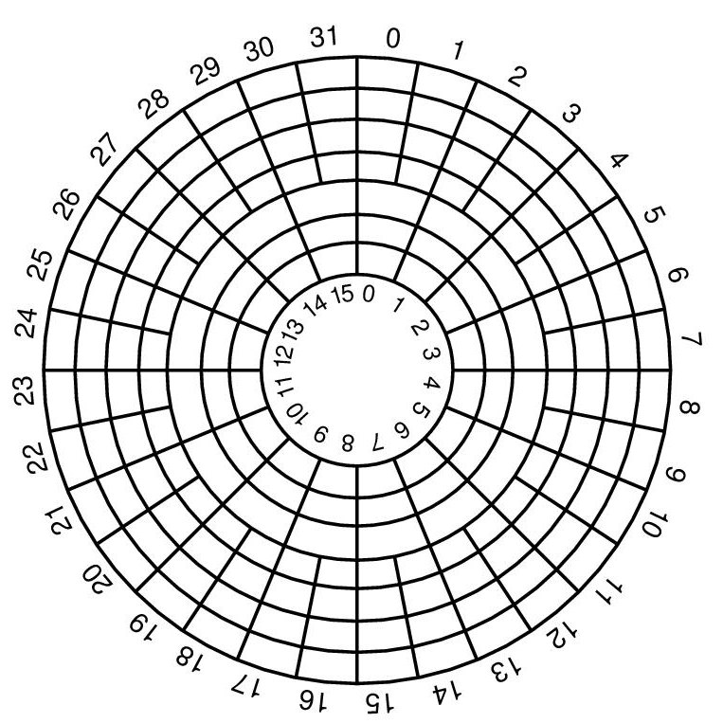
Disk “zones”
Outside tracks are longer than inside tracks
Two options
  Bits are “bigger”
  More bits (transfer faster)
Modern hard drives use second option
  More data on outer tracks
Disk divided into “zones”
  Constant sectors per track in each zone

Slide 24
Disk “addressing”
Millions of sectors on the disk must be labeled
Two possibilities
  Cylinder/track/sector
  Sequential numbering
Modern drives use sequential numbers
  Disks map sequential numbers into specific location
  Mapping may be modified by the disk
    Remap bad sectors
    Optimize performance
  Hide the exact geometry, making life simpler for the OS

Slide 25
Building a better “disk”
Problem: CPU performance has been increasing exponentially, but disk performance hasn’t
  Disks are limited by mechanics
Problem: disks aren’t all that reliable
Solution: distribute data across disks, and use some of the space to improve reliability
  Data transferred in parallel
  Data stored across drives (striping)
  Parity on an “extra” drive for reliability

Slide 26
Structure of a disk sector
Preamble
Data
ECC
Preamble contains information about the sector
  Sector number & location information
Data is usually 256, 512, or 1024 bytes
ECC (Error Correcting Code) is used to detect & correct minor errors in the data

Slide 27
Assignment
Improving the performance of a hardisk
  Conventional techniques
  RAID- 0,1,5
Security issues in operating systems
  Security problems
  Security mechanisms

Slide 28
Assignment
Disk “Zones”
  Zone bit recording

